Slide 1
Nubank Data Analyst Challenge
Luiz Eduardo Amaral

Slide 2

Problem Definition
Legacy warehouse
transactions table
Hard to query for a monthly bill.

Slide 3
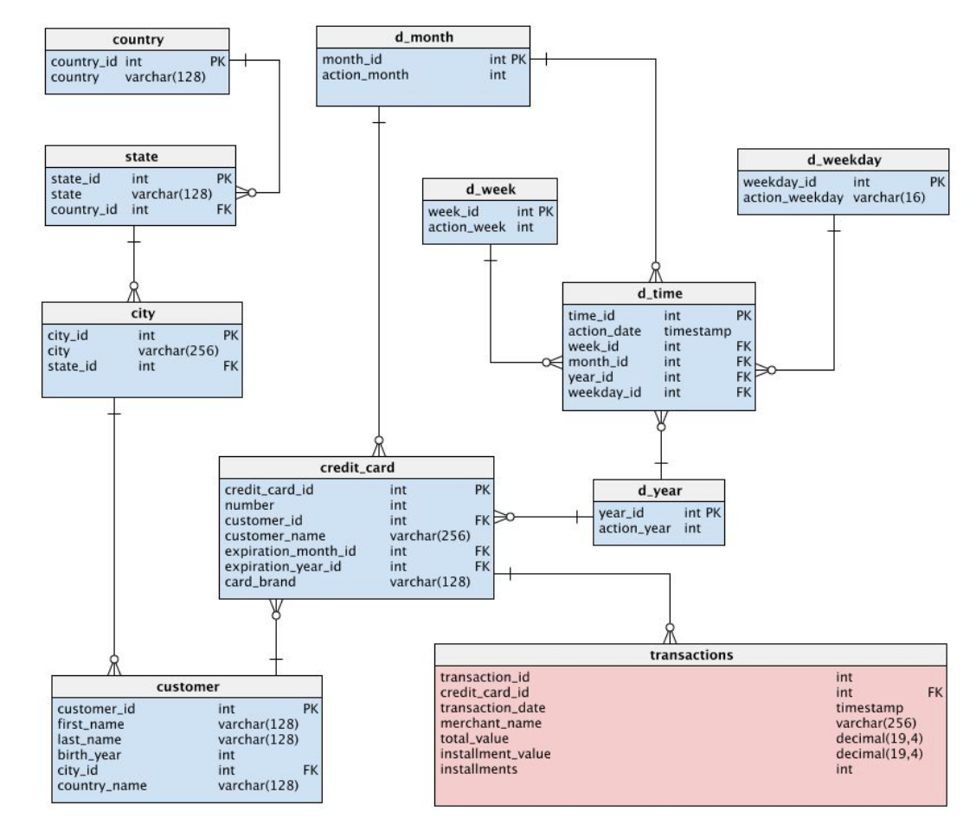

Slide 4
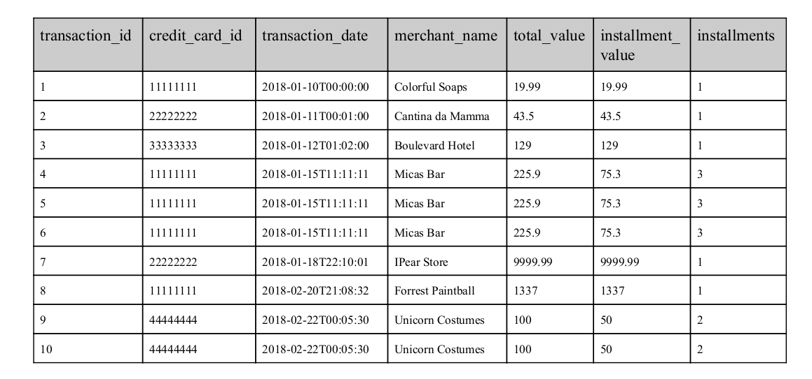

Slide 5
Problem Definition
Redesign the database
Build a query for the monthly bill
How to prevent these mistakes
How to better find, understand and consume the data

Slide 6
Redesigning the database

Slide 7
Dimensional Modeling Techniques (Kimball/Ross)
Star Schema
Fact Tables
Dimension Tables
Slowly Changing Dimension

Slide 8
Four-Step Dimensional Design Process (Kimball/Ross)
Select the business process.
Declare the grain.
Identify the dimensions.
Identify the facts.

Slide 9
Select the business process
We want to create monthly bills for the customers

Slide 10
Declare
the grain
Individual purchases of a customer and individual installments

Slide 11
Identify the dimensions
Customer
Credit card
Merchant
Date

Slide 12
Identify
the facts
Total value
Installment value
installments

Slide 13
Redesigning the database
One fact table:
Installments
Four dimension tables
Customer
Credit card
Merchant
Date

Slide 14
Dimension Tables
Dimension - merchant
merchant_id | int | PK
merchant_name | varchar(256)
Dimension - dates
date_id | int | PK
installment_date | date
transaction_date | date
Dimension - customer
customer_id | int | PK
first_name | varchar(128)
last_name | varchar(128)
birthday | date
city | varchar(128)
state | varchar(64)
country | varchar(64)
installments_value | decimal(19, 4)
Dimension - credit_card
credit_card_id | int | PK
number | int
name | varchar(256)
expiration_month | int
expiration_year | int
card_brand | int

Slide 15
Fact Tables
Fact Table - installments
transaction_id | int | PK
installment_number | int | PK
customer_id | int | FK
credit_card_id | int | FK
merchant_id | int | FK
date_id | int | FK
total_installments | int
installment_value | decimal(19, 4)
total_value | decimal(19, 4)

Slide 16
Complete Model
Dimension - merchant
merchant_id | int | PK
merchant_name | varchar(256)
Fact Table - transactions
transaction_id | int | PK
installment_number | int | PK
customer_id | int | FK
credit_card_id | int | FK
merchant_id | int | FK
date_id | int | FK
total_installments | int
installment_value | decimal(19, 4)
total_value | decimal(19, 4)
Dimension - dates
date_id | int | PK
installment_date | date
transaction_date | date
Dimension - customer
customer_id | int | PK
first_name | varchar(128)
last_name | varchar(128)
birthday | date
city | varchar(128)
state | varchar(64)
country | varchar(64)
installments_value | decimal(19, 4)
Dimension - credit_card
credit_card_id | int | PK
number | int
name | varchar(256)
expiration_month | int
expiration_year | int
card_brand | int

Slide 17
Demo

Slide 18
2. Build a query for the monthly bill

Slide 19
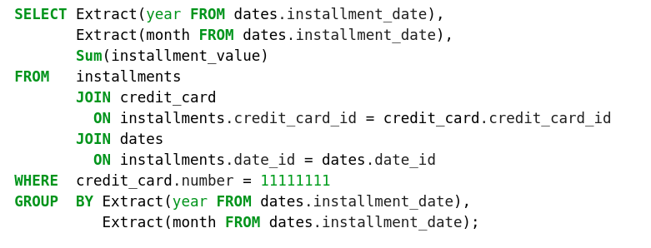
Query

Slide 20
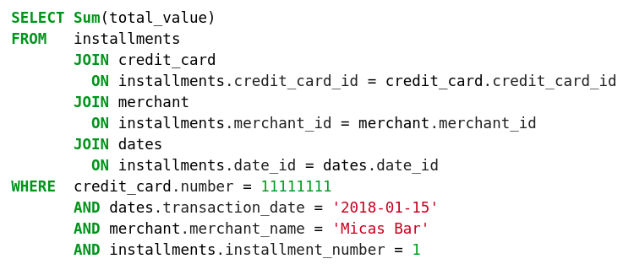
Query

Slide 21
3. How to prevent these mistakes

Slide 22
What happened?
Implicit Information
Snowflake Schema → Complex Queries

Slide 23
How to solve it
Four-Step Dimensional Design Process
Star Schema
Slow Changing Dimensions

Slide 24
4. How to better find, understand and consume the data
Follow Design Patterns
Have several tools under your belt

Slide 25
Thank You!
Questions?
Nubank Challenge - 09/2018
Luiz Eduardo Amaral

